Slide 1
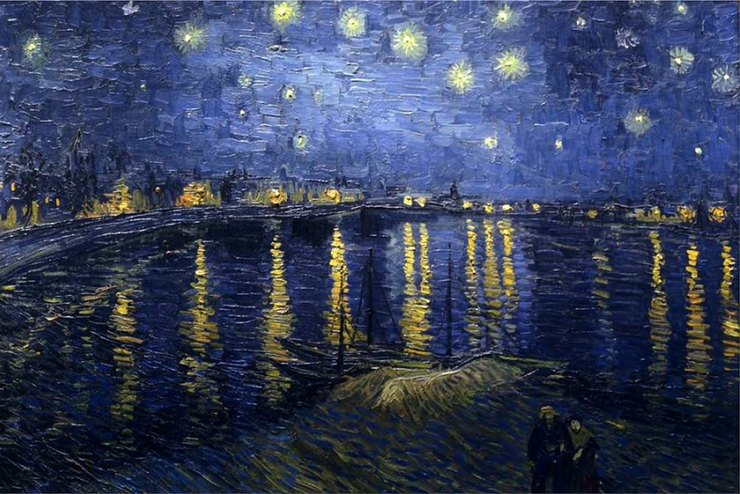
POST-IMPRESSIONISM
History of Modern Art
BFA-III (Visual Arts)
Course Incharge: Ms. Sidra Liaqat
Institute of Design & Visual Arts, LCWU

Slide 2
Cezanne is the fore-runner of Cubism,
Van Gogh is said to be the fore-runner of Expressionism,
Gauguin – the fore-runner of Symbolism,
Seurat – the fore-runner of Pointillism.

Slide 3
Emotional Symbolism
Evocative Color
Distinctive Brushstrokes

Slide 4
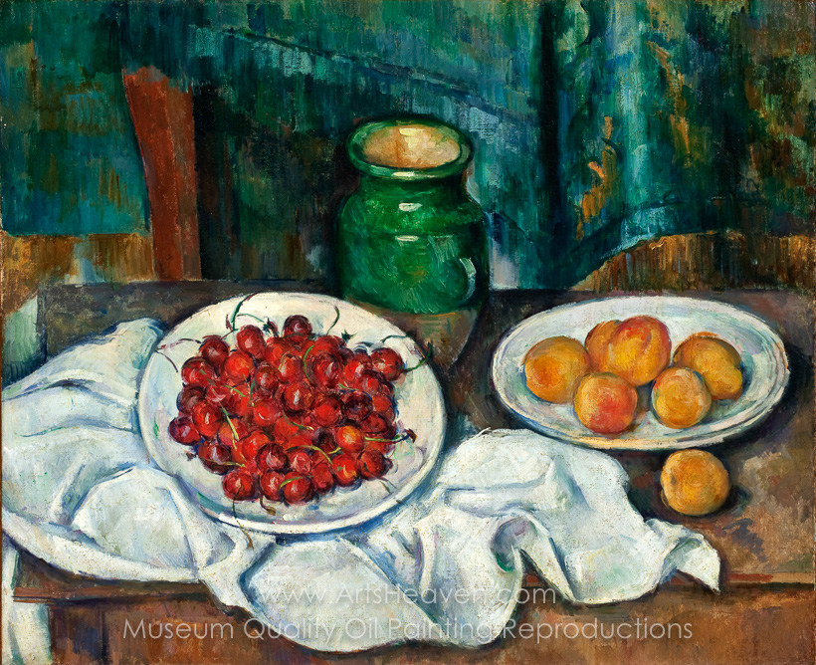
PAUL CÉZANNE
“Still Life with Plate of Cherries”
(1885)

Slide 5
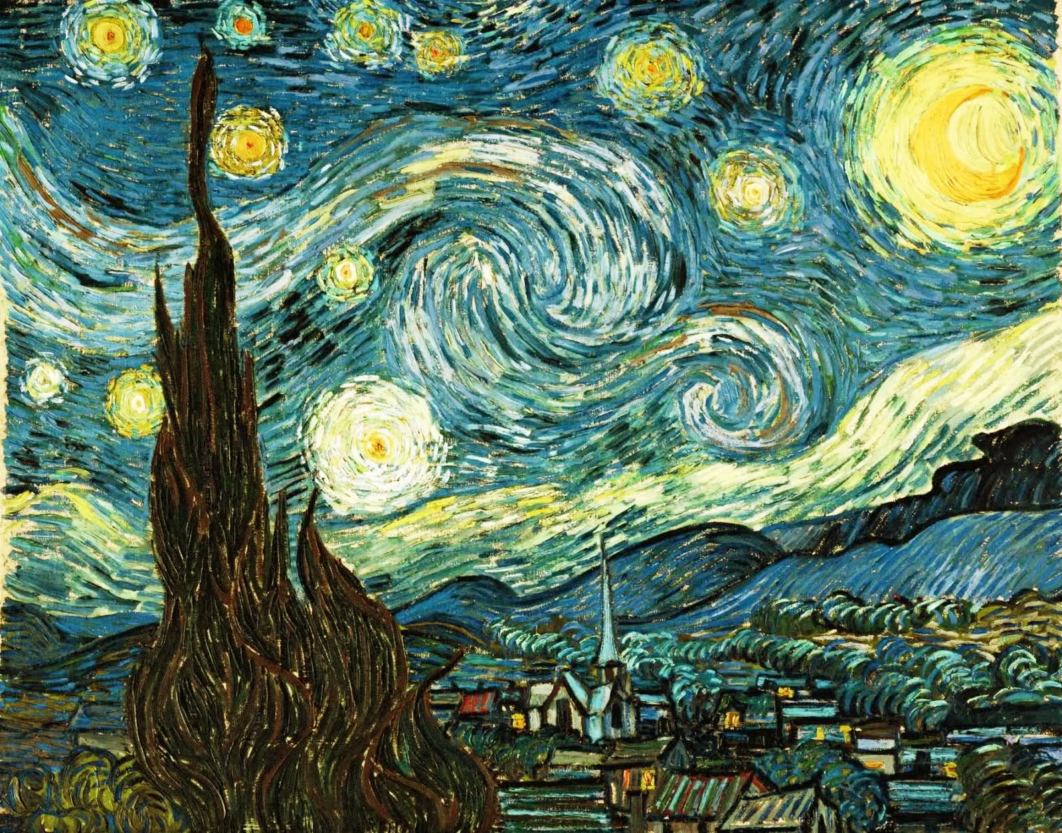
VINCENT VAN GOGH
“The Starry Night”
(1889)

Slide 6
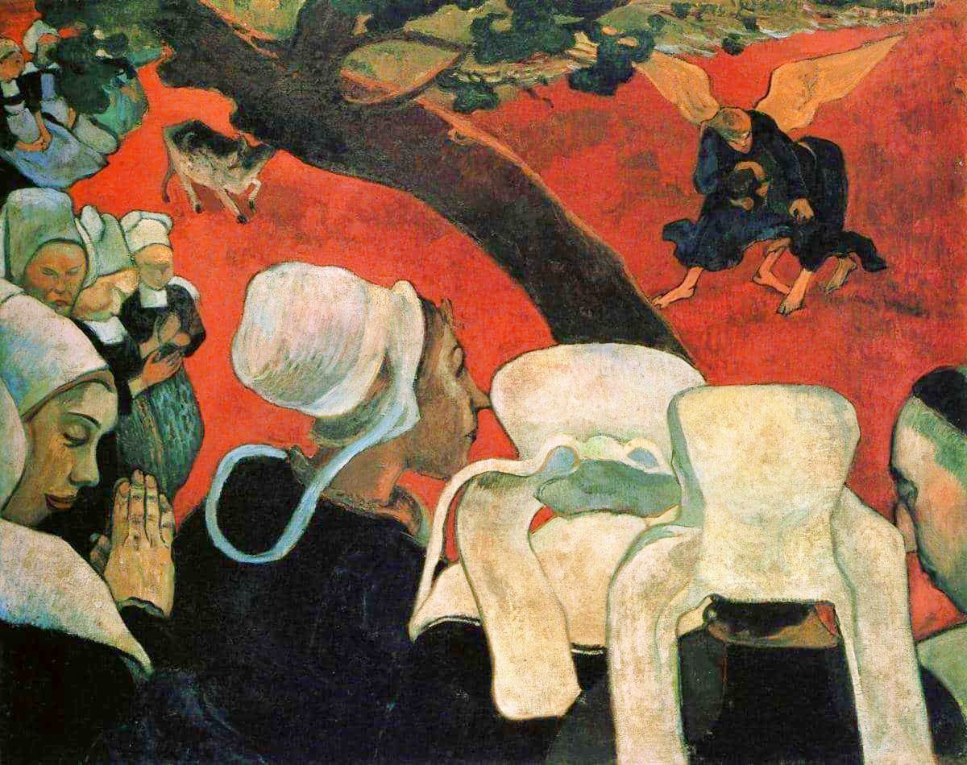
PAUL GAUGUIN
“Vision After the Sermon”
(1888)

Slide 7
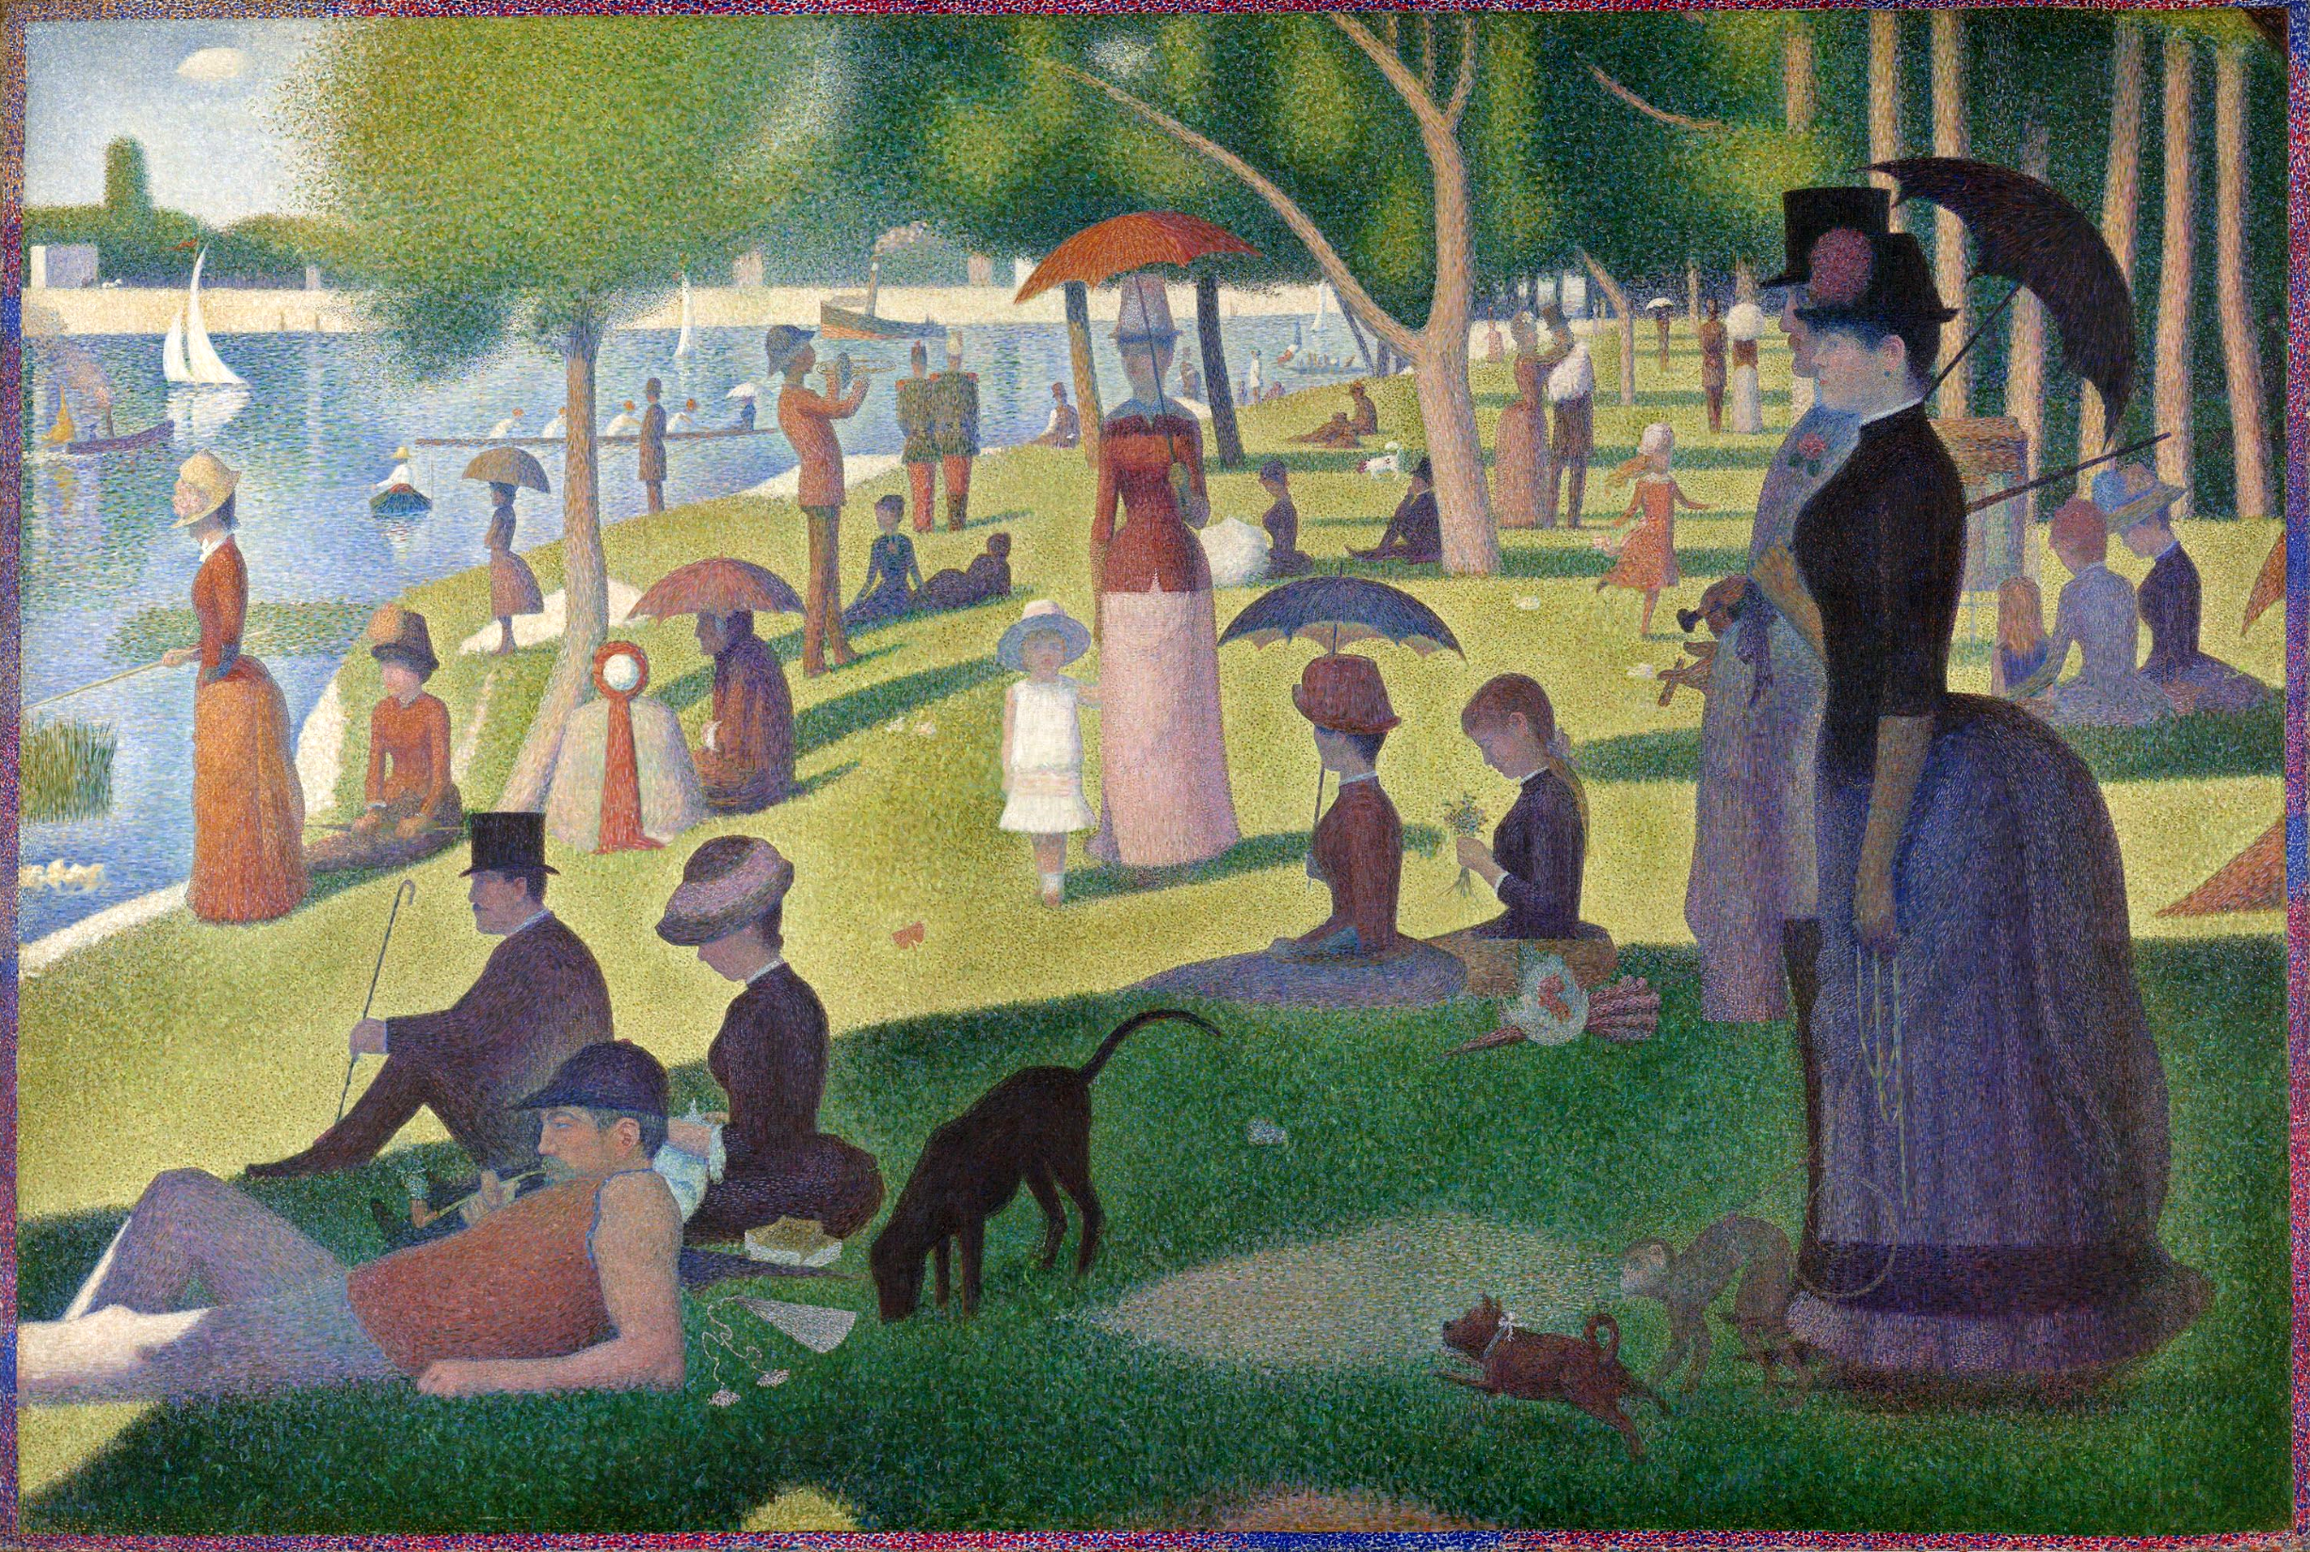
GEORGES SEURAT
“A Sunday Afternoon on the Island of La Grande Jatte”
(1886)

